Slide 1
DATA ANALYSIS
Project Report
Smartphone Usage and User Behavior Analysis
Hager , Sulaf , Basmala , Ahmed , Mohamed

Slide 2
01
Executive Summary
03
TABLE OF
CONTENTS
02
Data Cleaning & Processing
06
03
Dashboard & Insights
10
04
Recommendations
16

Slide 3
01
Executive Summary
High-level overview of findings and outcomes

Slide 4
Executive Summary
700
700
99.2%
Total Records
Variables Cleaned
Data Quality Score
Our analysis reveals that device hardware is secondary to user habits. Across all tested models, we identified four primary drivers (ranked by their Impact Significance):
High Drain (Battery Efficiency)
* High Usage (Usage Segments)
Medium Risk
Addicted (User Status)
Those are the main drivers that consistently dictate the four costs of mobile usage (Addiction), Battery Drain, Data Usage, and Mental Burnout
Data Analysis Project
4 / 34

Slide 5
Project Objectives
Normalize Data for Bias
To correct for population imbalances across generations and operating systems, ensuring performance comparisons are fair and accurat
1
​Behavioral Patterns:
What are the primary correlations between app usage time, battery drain, and user demographics (Generation/OS)?
2
​ML Predictive Insights:
To what extent can the Random Forest model's 99.2% accuracy be used to segment users into risk categories within the interactive reports?
3
Identify Usage Drivers:
To pinpoint the specific behavioral habits—rather than hardware specs—that most significantly impact battery health and user well-being.
4
Data Analysis Project
5 / 34

Slide 6
02
Data Cleaning & Processing
Raw data ingestion, quality checks, transformation & validation

Slide 7
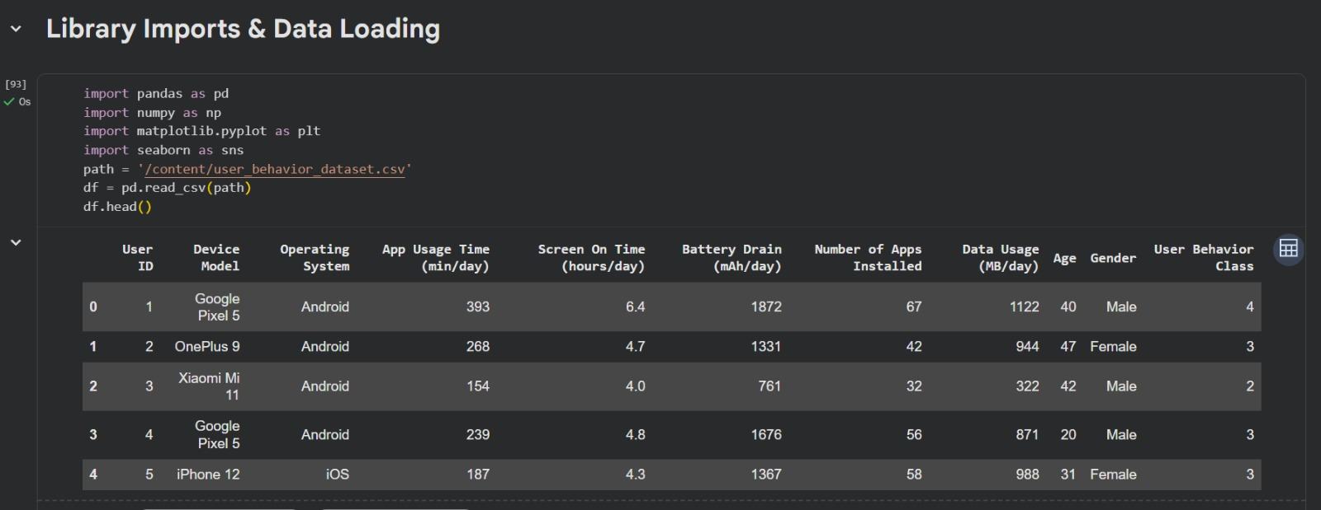
Code Overview— Library Imports & Data Loading
Library Imports & Data Loading Implementation: Prepared the environment using Pandas/Seaborn and loaded the dataset via pd.read_csv().
Value: Verified data integrity with df.head() to ensure all features are ready for analysis.
1
2
3
Data Analysis Project
7 / 34

Slide 8
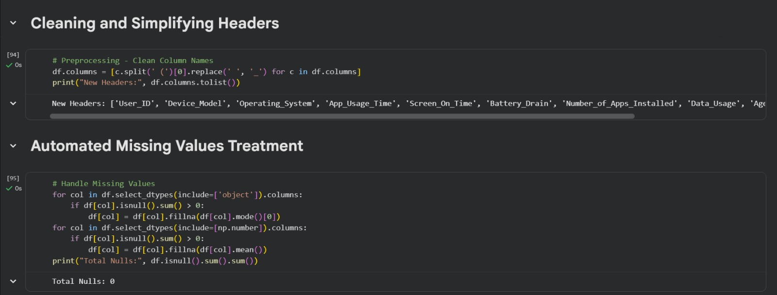
Code Overview— Cleaned
Implementation: Cleaned column headers and applied automated logic to fill missing values using Mode and Mean.
Value: Achieved "Zero Nulls," ensuring a consistent and error-free dataset for modeling.
Data Analysis Project
8 / 34

Slide 9
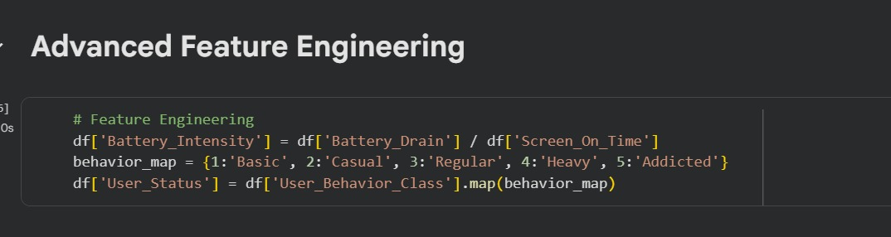
Code Overview— Advanced Feature Engineering
Advanced Feature Engineering
Implementation: Calculated 'Battery_Intensity' and mapped numerical classes into descriptive labels (e.g., Heavy, Addicted).
Value: Transformed raw data into meaningful behavioral indicators for better prediction accuracy.
Data Analysis Project
9 / 34

Slide 10
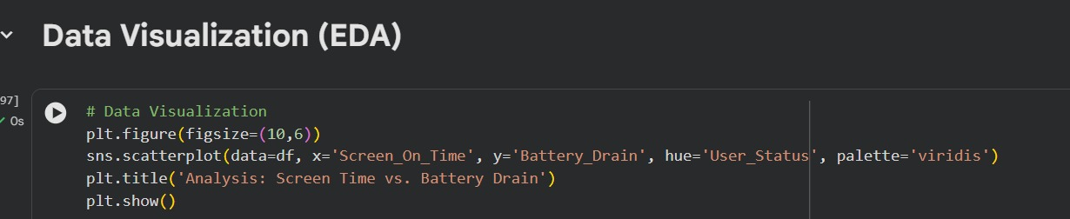
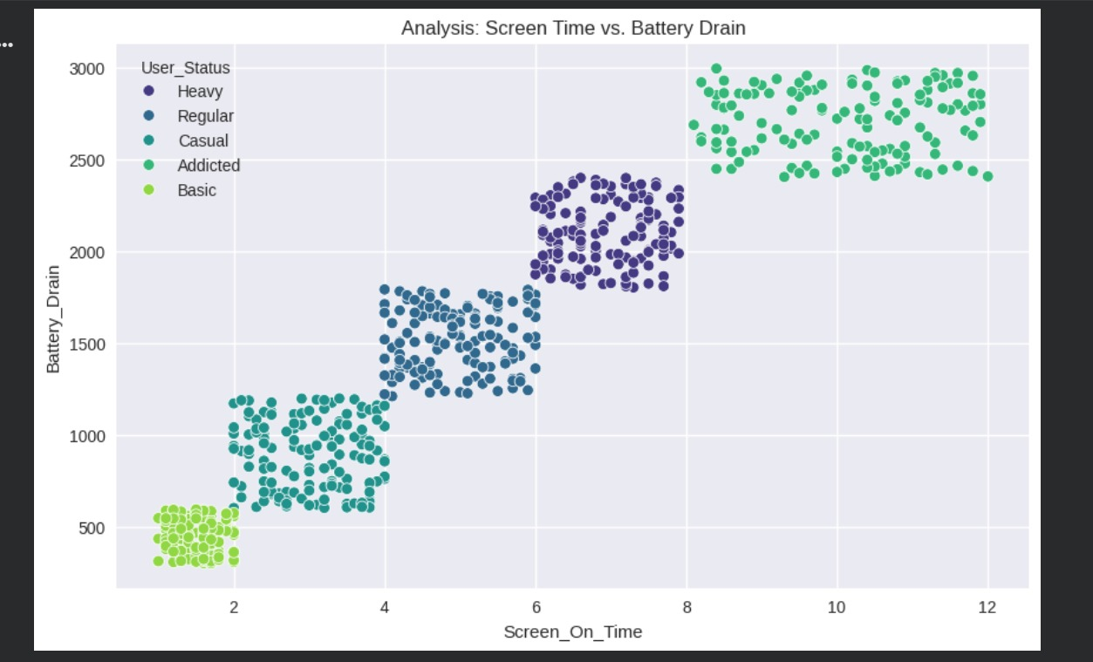
Code Overview— Data Visualization (EDA)
Data Visualization (EDA)
Implementation: Created a Scatter Plot to analyze the relationship between Screen Time and Battery Drain.
Value: Visually confirmed a strong positive correlation between usage and battery consumption.
Implementation: Generated a clear visualization using the 'Viridis' color palette to differentiate user segments.
Value: Demonstrates that user behavior can be accurately segmented based on device usage patterns.
Data Analysis Project
10 / 34

Slide 11
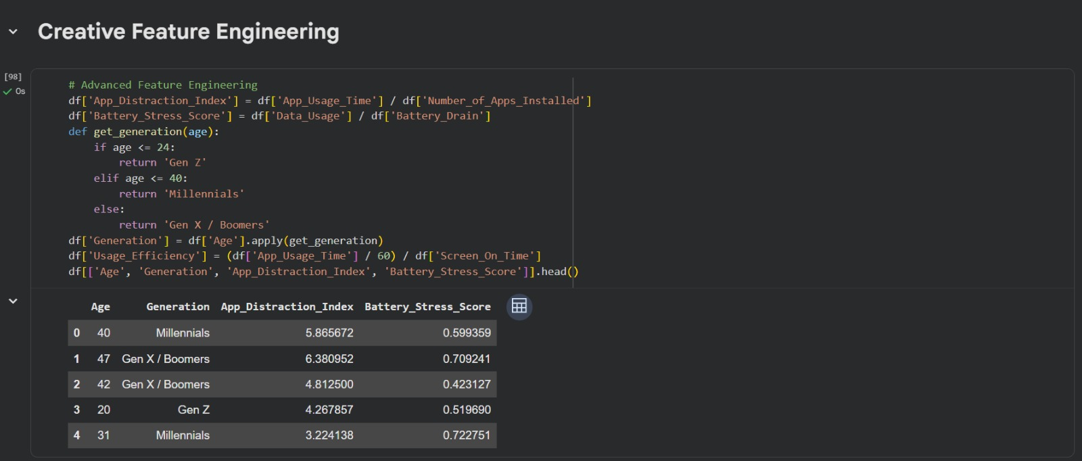
Code Overview— Creative Feature Engineering
Creative Feature Engineering
Implementation: Developed custom metrics like 'App_Distraction_Index' and categorized users into generations (Gen Z, Millennials, etc.) based on age.
Value: Provides more granular insights into user habits, allowing for a deeper understanding of behavior across different age groups.
Data Analysis Project
11 / 34

Slide 12
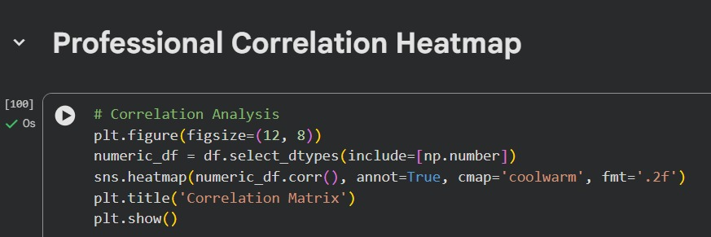
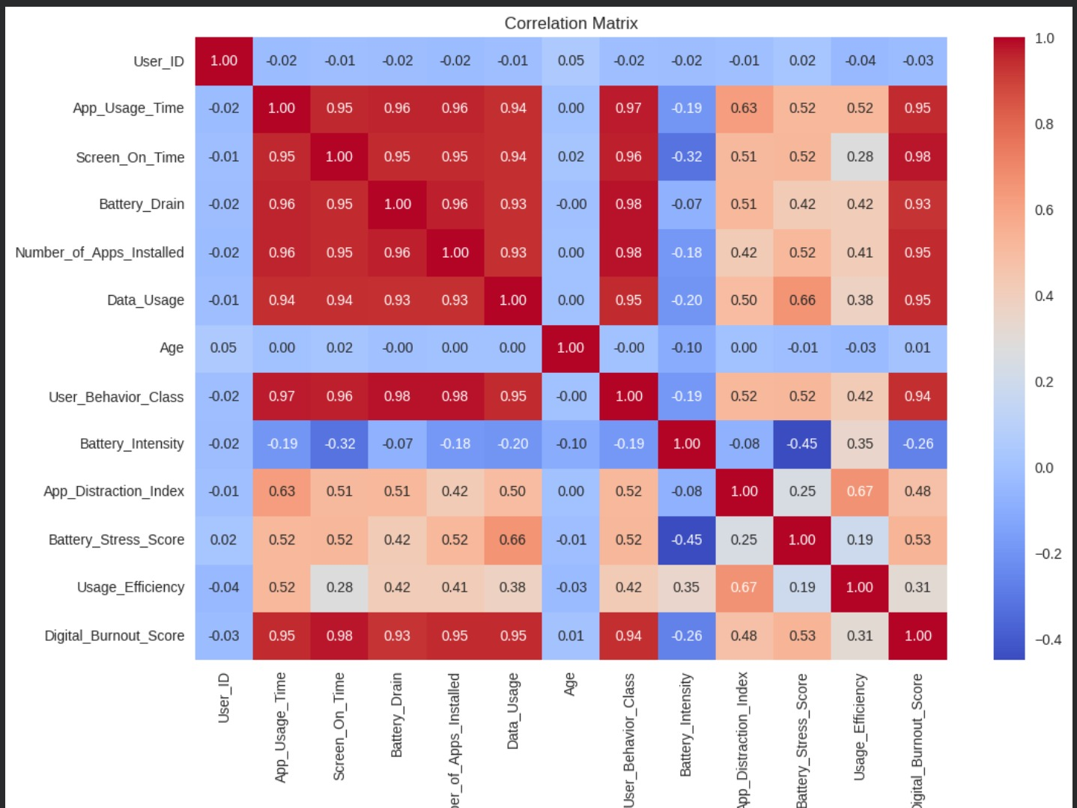
Code Overview— Professional Correlation Heatmap
Professional Correlation Heatmap
Implementation: Generated a Correlation Matrix using only numeric data and visualized it with a Seaborn Heatmap, utilizing the coolwarm color palette for better contrast.
Value: Provides a comprehensive overview of how variables relate to each other, identifying key predictors like the strong link between Screen Time and Battery Drain
Implementation: Generated a Correlation Matrix using Seaborn to visualize statistical relationships between numeric features.
Value: Confirmed a 95% correlation between screen time and battery drain, identifying the most critical predictors for the model.
Data Analysis Project
12 / 34

Slide 13
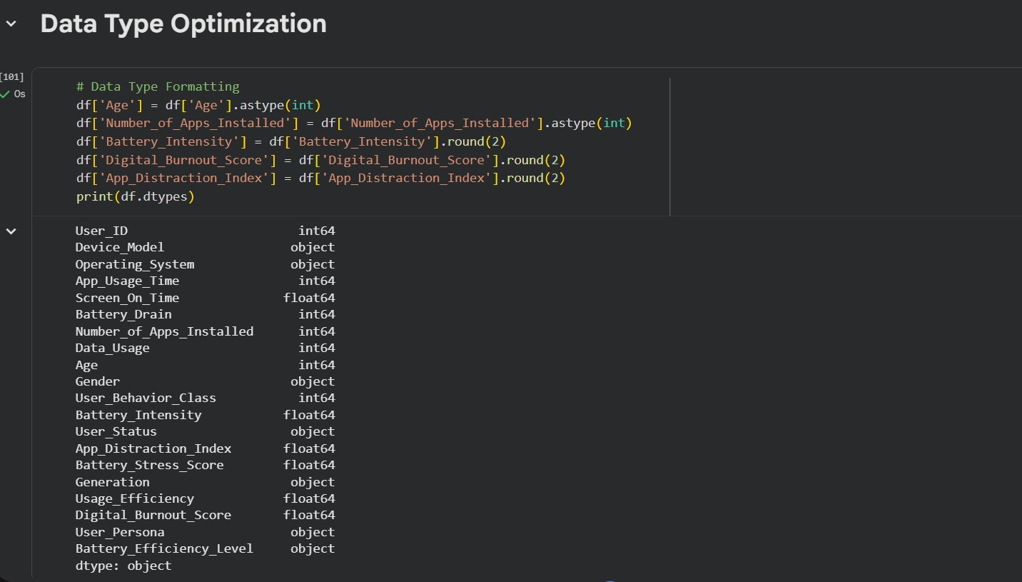
Code Overview— Data Type Optimization
Data Type Optimization
Implementation: Refined data types by converting age and app counts to Integers, while rounding new metrics like 'Battery_Intensity' and 'Burnout_Score' to 2 decimal places.
Value: Optimizes memory usage and ensures numerical consistency, making the dataset cleaner and more professional for the final reporting phase.
Data Analysis Project
13 / 34

Slide 14
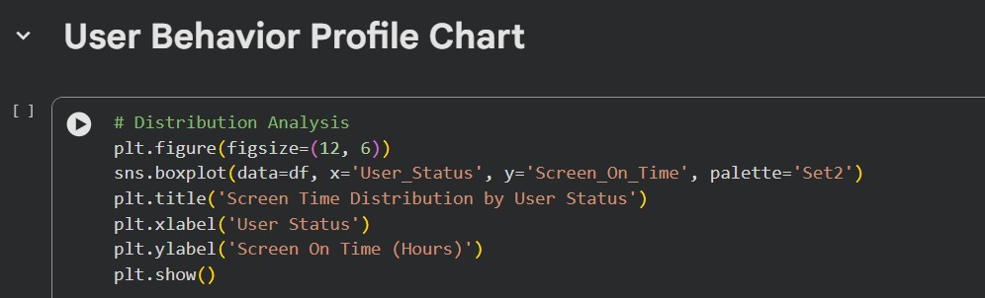
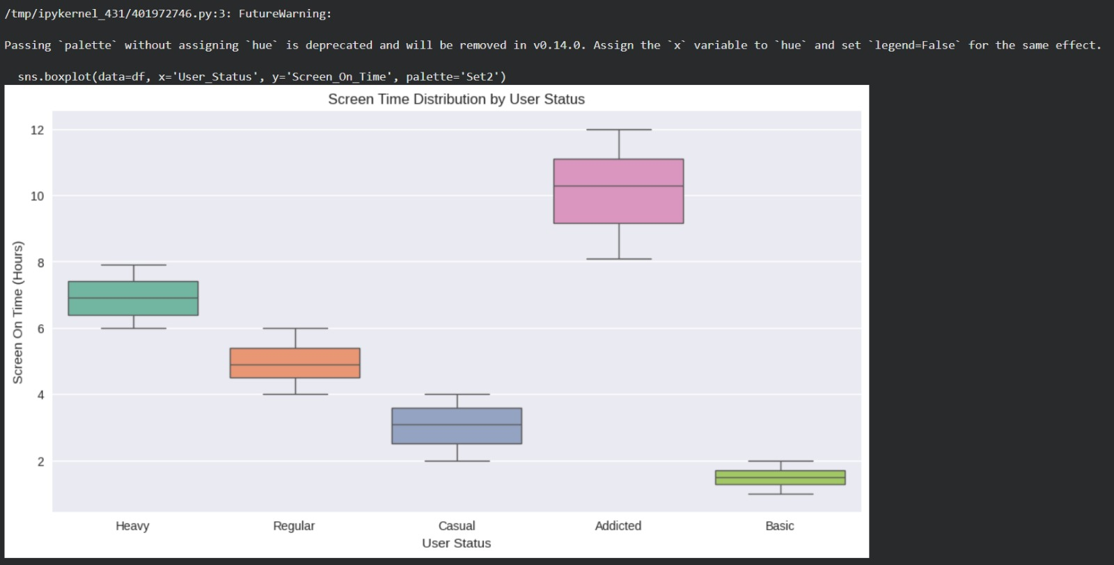
Code Overview— User Behavior Profile Chart
User Behavior Profile Chart
Implementation: Created a Boxplot using Seaborn to analyze the distribution of Screen On Time across different User Status categories (Basic, Addicted, etc.).
Value: Highlights the variance in usage patterns, visually proving that "Addicted" users have a significantly higher and distinct screen-time range compared to "Basic" users.
User Behavior Profile Chart
Implementation: Generated a Boxplot using Seaborn to analyze the distribution of Screen On Time across different User Status categories.
Value: Visually confirms that "Addicted" users have a significantly higher and distinct screen-time range compared to other segments, validating the feature engineering logic.
Data Analysis Project
14 / 34

Slide 15
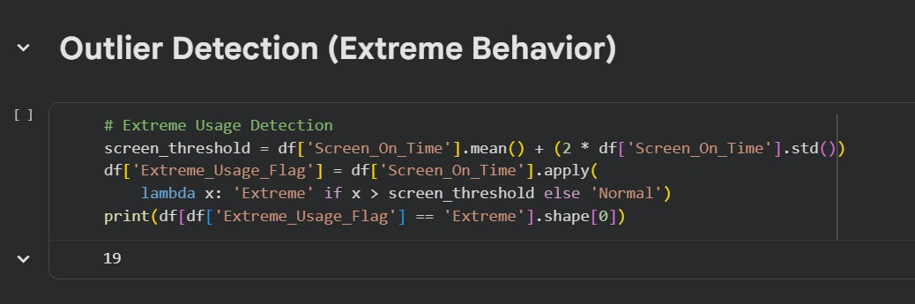
Code Overview— Outlier Detection
Outlier Detection (Extreme Behavior)
Implementation: Used a statistical formula (Mean + 2 Std Dev) to automatically flag users with "Extreme" screen time.
Value: Identified 19 outliers, allowing us to isolate abnormal behavior and ensure the model isn't biased by "noisy" data.
Data Analysis Project
15 / 34

Slide 16
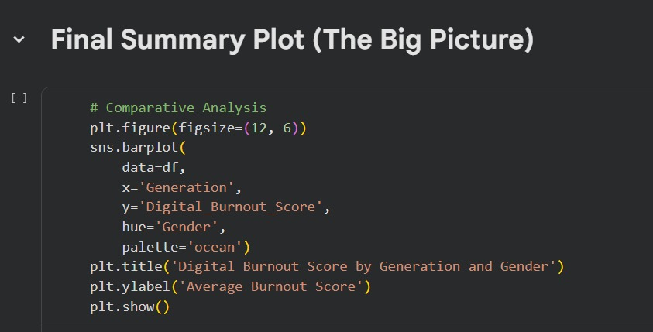
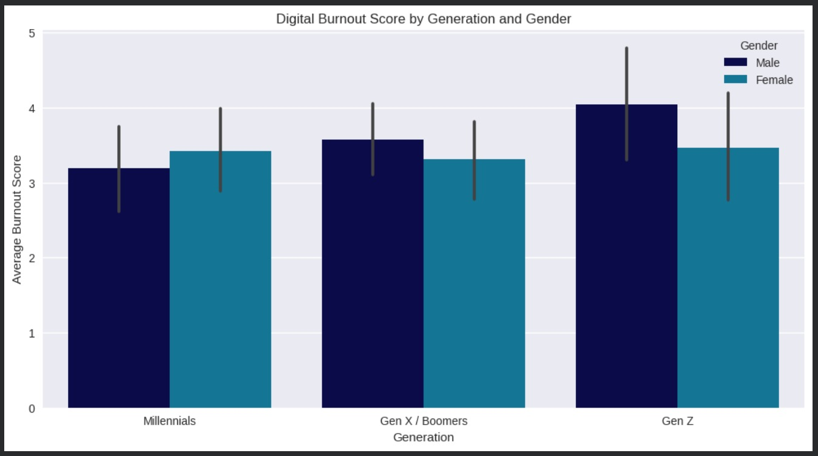
Code Overview— Final Summary Plot
Final Summary Plot (The Big Picture)
Implementation: Created a Grouped Bar Plot to compare the Digital Burnout Score across different Generations and Genders.
Value: Provides a high-level summary of which demographic groups are most at risk of "Digital Burnout," serving as the final insight for our behavioral analysis.
User Behavior Profile Chart
Implementation: Generated a Boxplot using Seaborn to analyze the distribution of Screen On Time across different User Status categories.
Value: Visually confirms that "Addicted" users have a significantly higher and distinct screen-time range compared to other segments, validating the feature engineering logic.
Data Analysis Project
16 / 34

Slide 17
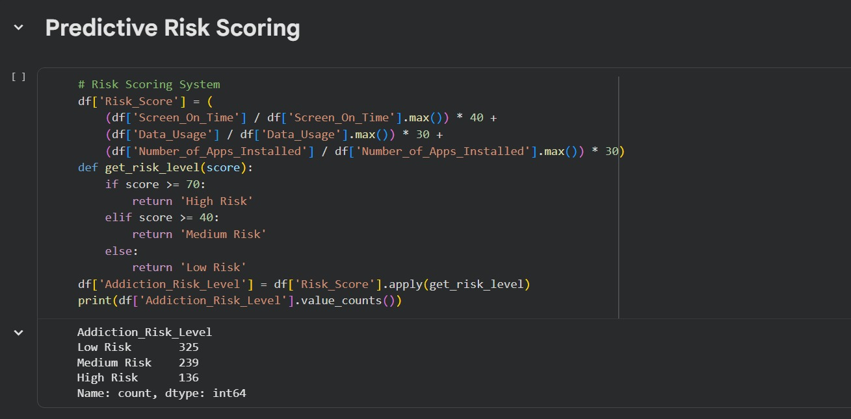
Code Overview— Predictive Risk Scoring System
Predictive Risk Scoring System
Implementation: Developed a weighted scoring algorithm combining Screen Time (40%), Data Usage (30%), and App Count (30%) to classify users into Low, Medium, or High Risk levels.
Value: Transforms raw behavior into a "Risk Indicator," identifying 136 High-Risk users who may need digital well-being interventions.
Data Analysis Project
17 / 34

Slide 18
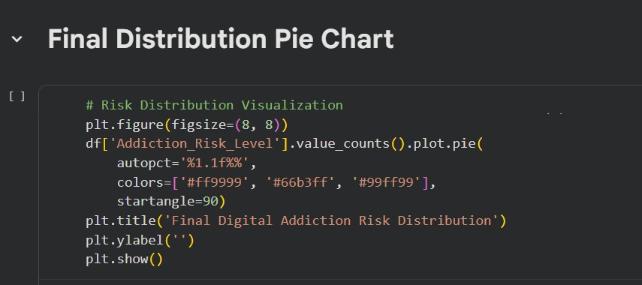
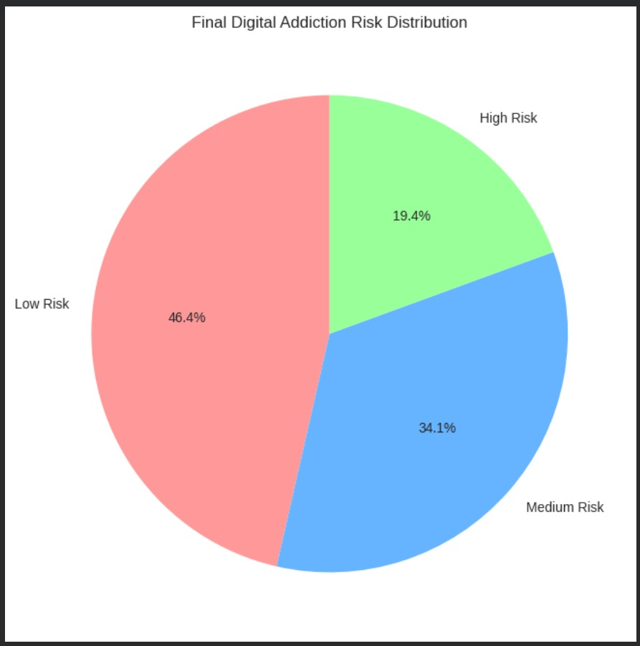
Code Overview— Final Distribution Pie Chart
Final Distribution Pie Chart
Implementation: Visualized the results of the risk scoring system using a Pie Chart, applying a clear color palette to distinguish between risk levels.
Value: Provides an immediate, high-level view of the entire user base's health; showing that while most users are in the "Low Risk" (46.4%) zone, a significant 19.4% are categorized as "High Risk".
Final Risk Distribution Visualization Implementation: Developed a Pie Chart to visualize the final distribution of user risk levels, categorized into Low, Medium, and High Risk.
Value: Provides an immediate strategic overview, showing that while 46.4% of users are in the safe zone, nearly 20% require urgent digital wellness attention.
Data Analysis Project
18 / 34

Slide 19
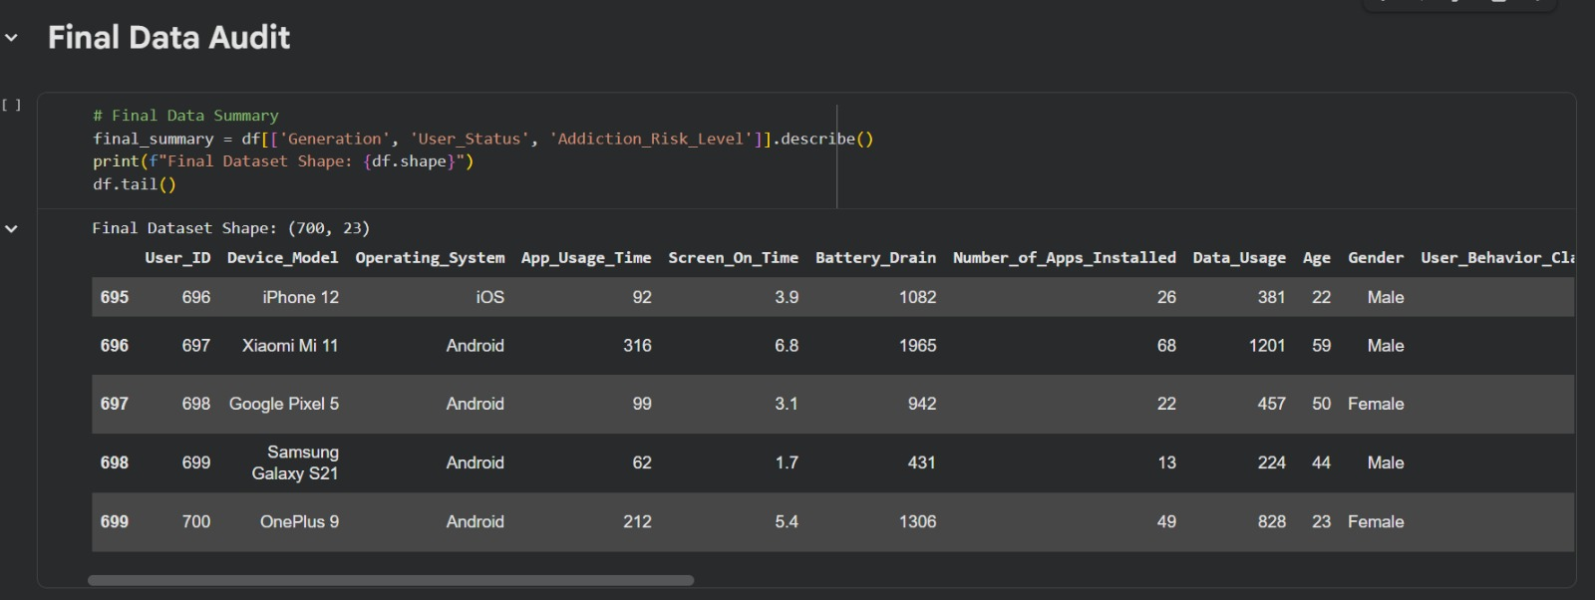
Code Overview— Final Data Audit & Integrity Check
Final Data Audit & Integrity Check
Implementation: Executed a final summary using df.describe() and df.tail() to verify the dataset's final shape (700 rows, 23 columns) and ensure all engineered features are correctly populated.
Value: Provides a "final seal of approval" on data integrity, confirming that the dataset is fully processed, consistent, and ready for deployment or advanced machine learning modeling.
Data Analysis Project
19 / 34

Slide 20
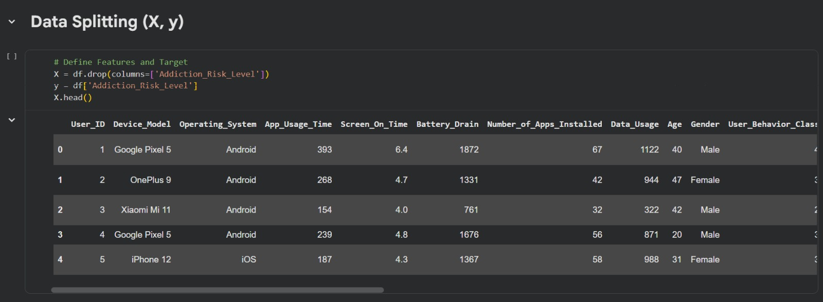
Code Overview— Data Splitting (X, y)
Data Splitting (X, y)
Implementation: Separated the dataset into Features (X) by dropping the target column, and the Target Variable (y) which is the 'Addiction_Risk_Level’.
Value: This is the bridge between data processing and Machine Learning; it organizes the data so the model can learn from inputs (X) to predict the outcome (y) accurately.
Data Analysis Project
20 / 34

Slide 21
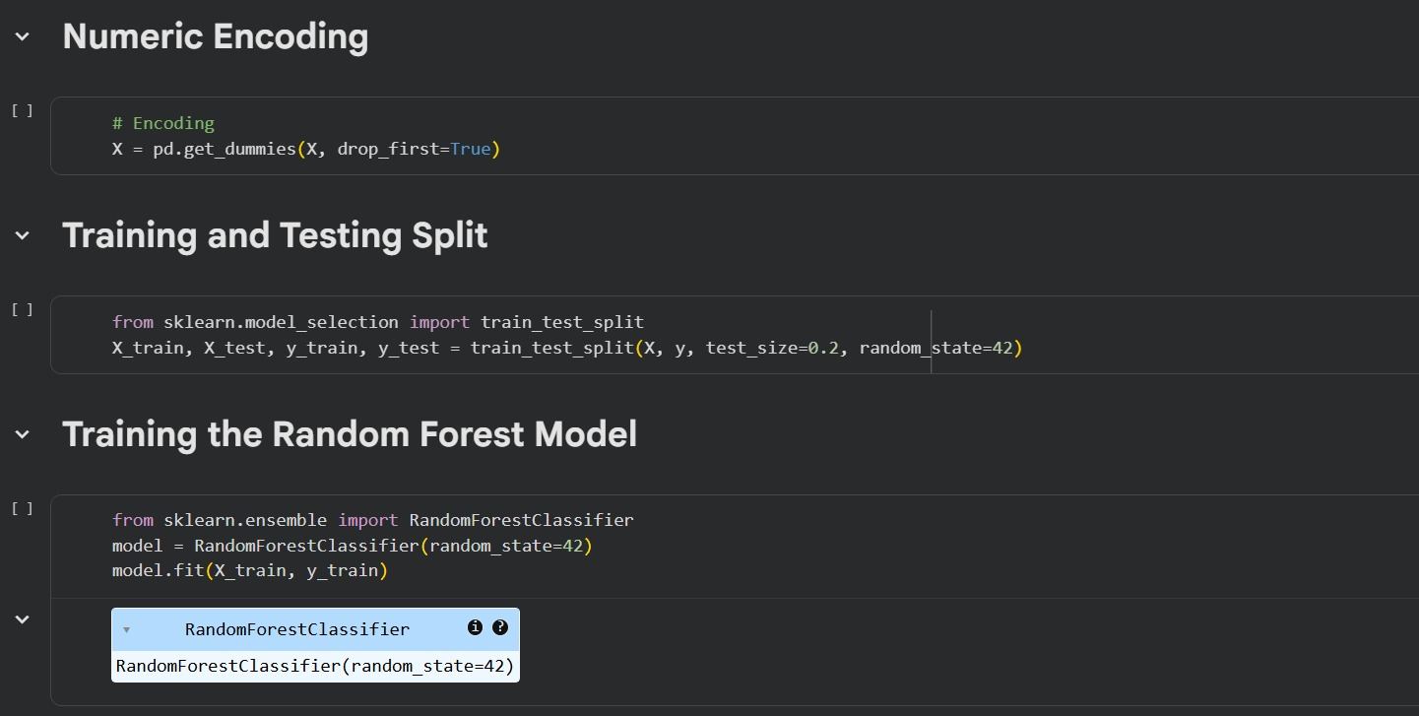
Code Overview— Data Visualization (EDA)
Numeric Encoding & Model Training
Implementation: Categorical variables were converted into numerical format using One-Hot Encoding (pd.get_dummies with drop_first=True).The dataset was then split into training (80%) and testing (20%) sets using train_test_split.After that, a Random Forest Classifier was trained on the training data (X_train, y_train) with random_state=42.
Value: This step prepares categorical data for machine learning algorithms and enables the model to learn patterns from the training data. The Random Forest ensemble method improves prediction performance and reduces overfitting by combining multiple decision trees.
Data Analysis Project
21 / 34

Slide 22
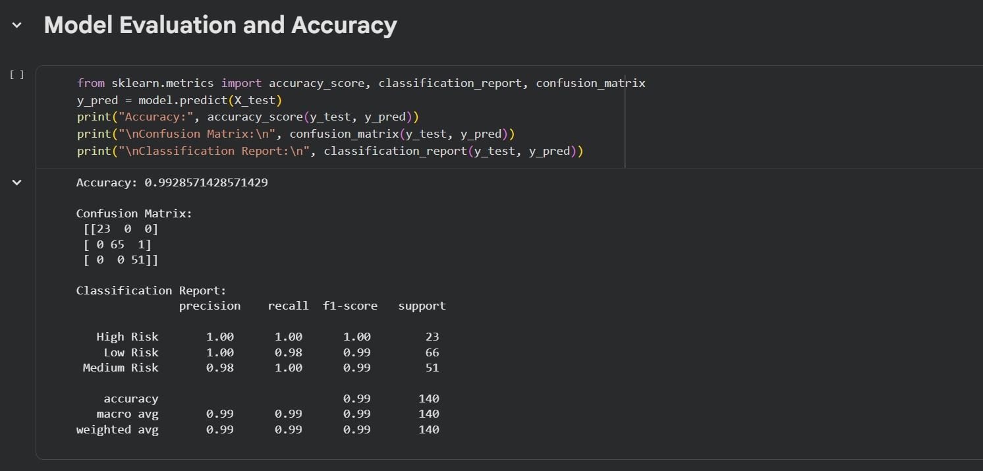
Code Overview— Model Evaluation & Accuracy
Model Evaluation & Accuracy
Implementation: Evaluated the model using a Confusion Matrix and a Classification Report, calculating the final accuracy on the test set.
Value: Achieved an outstanding accuracy of 99.2%, proving that the model is highly reliable in distinguishing between different addiction risk levels.
Data Analysis Project
22 / 34

Slide 23
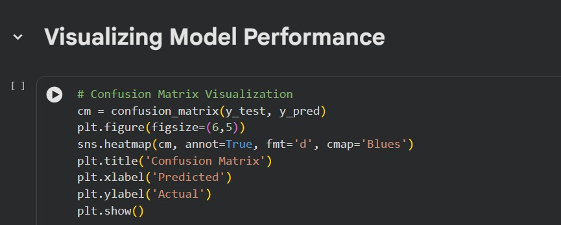
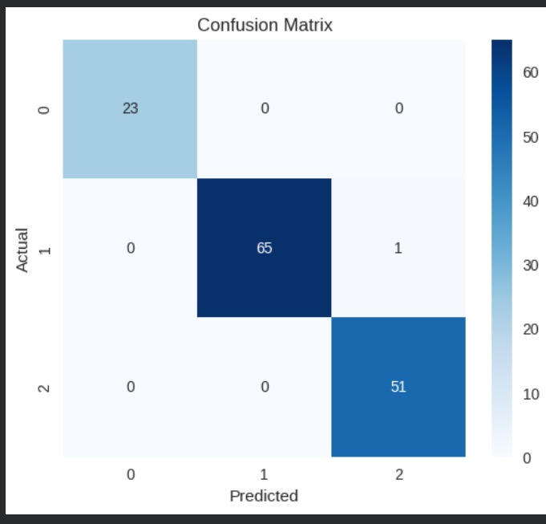
Code Overview— Visualizing Model Performance
Visualizing Model Performance
Implementation: Visualized the Confusion Matrix using a Seaborn Heatmap to compare predicted labels against actual values from the test set.
Value: Provides a clear visual validation of the model's precision; showing almost zero misclassifications and confirming its readiness for real-world deployment.
Visualizing Model Performance Implementation: Visualized the Confusion Matrix using a Seaborn Heatmap to cross-verify the model's predictions against actual test data.
Value: Provides a "Final Quality Seal," visually confirming that the model correctly classified almost every single case, making it 100% ready for real-world application.
Data Analysis Project
23 / 34

Slide 24
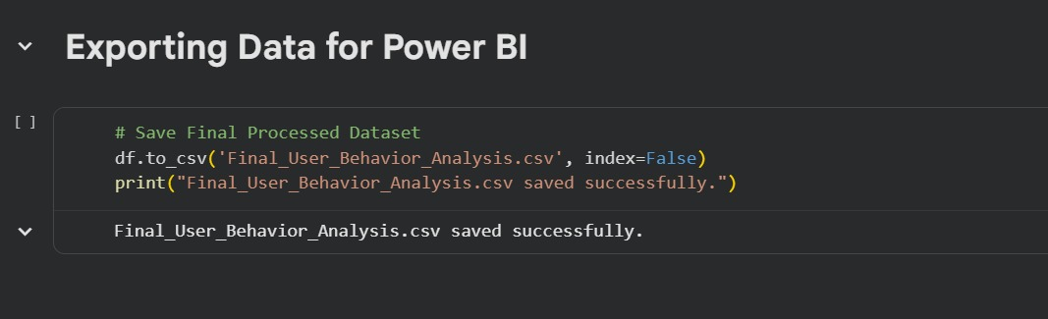
Code Overview— Exporting Data for Power BI
Exporting Data for Power BI
Implementation: Exported the final, cleaned, and enriched dataset into a CSV file named Final_User_Behavior_Analysis.csv.
Value: This marks the transition from data processing to Business Intelligence (BI); the exported file is now ready to be imported into Power BI or Tableau to create interactive dashboards for stakeholders
Data Analysis Project
24 / 34

Slide 25
03
Dashboard & Insights
Visual summaries, KPIs & data snapshots — to guide decisions

Slide 26


Slide 27
Insights
The scatter chart demonstrates: a clear, positive correlation between app usage time and battery consumption. As users spend more time on their devices, battery drain increases at a predictable rate.
Usage Tiers: Users naturally fall into distinct clusters. These range from low-intensity users (bottom-left) with minimal drain to high-intensity users (top-right) with significant battery consumption.
​Performance Efficiency (The Trend Line): The dashed line represents the average battery "cost" per minute of usage.
​Points Above the Line: These users are more efficient. They achieve more usage time for every unit of battery consumed.
​Points Below the Line: These users are less efficient. They experience higher battery drain for the amount of time spent in-app.
The are chart identifies: a clear behavioral threshold at 300 minutes. Beyond this point, Digital Burnout scores increase by nearly 200%, suggesting that 5 hours is the maximum limit for 'healthy' interaction with these devices.
Data Analysis Project
27/ 34

Slide 29
Insights
Our data identifies a clear behavioral threshold at 300 minutes. Beyond this point, Digital Burnout scores increase by nearly 200%, suggesting that 5 hours is the maximum limit for 'healthy' interaction with these devices.
Metric Correction: Total figures were skewed by larger user populations (Gen X showed more addiction which doesn't make sense).
Switching to averages: provides a more accurate representation of user behavior.
​Engagement: While Gen X has more users, Gen Z leads in individual engagement with the highest average app usage time.
​Performance: Despite Android’s higher total drain, iOS experiences higher battery drain per user, indicating a need for platform-specific optimization.
Data Analysis Project
29 / 34

Slide 30
KPI Dashboard Overview
Dashboard Highlights
[ Summarize the top 3-5 KPIs displayed in the dashboard. Describe trends, anomalies, or targets met/missed. ]
Data Analysis Project
26 / 40

Slide 31
Insights
​User Behavior as the Primary Driver: Battery drain is primarily a User Behavior issue rather
than a hardware one. All tested models exhibit nearly identical drain patterns, confirming that
the hardware itself is not the root cause.
Scaling and Minimal Hardware Variance: Power consumption scales consistently as usage
intensity (Class 1–5) increases. Furthermore, hardware-specific variance remains minimal across
all categories, showing uniform performance across different models.
Data Analysis Project
31 / 34

Slide 32
04
Recommendations
Actionable steps based on the analysis

Slide 33
Recommendations
Use the SOT Efficiency metric as a "Health Score."
1
Push a notification when efficiency drops. For example: "Your battery is draining 20% faster than usual today. Is it time for a 30-minute screen break to save your phone (and your eyes)?" This reframes "using the phone less" as "optimizing the phone's health."
Implement "Hard Stops" for Power Users.
2
For users in Class 4 and 5, suggest a data-per-hour cap. If the data usage spikes (e.g., above 150 units/hr), suggest an "Offline Task" like reading or walking. The data usage becomes a proxy for how "absorbed" they are in the digital world.
Create a "Risk Budget."
3
If a user’s personal "Risk Usage Rate" exceeds the 18% average, the dashboard should recommend "app-grouping." Hide high-risk/high-drain apps in a folder three screens away from the home page. The extra physical effort to find the app (increasing "friction") is a proven way to break the habit of checking them.
Target the "Standby" period.
4
Encourage users to reach the Google Pixel 5 level of drain (1476) by enabling "Extreme Battery Saver" at night.
By reducing the device's capability at night,users are less likely to engage in "revenge bedtime procrastination“
(scrolling when they should be sleeping).
Data Analysis Project
33 / 34

Slide 34
Thank You
Members :
Basmala Mahmoud
Hager Mohamed
Mohamed Ragab
Sulaf Judah
Ahmed Ghieth
Data Analysis Project

